Slide 1
Chapter-8 Properties of Secure communication
CRYPTOGRAPY

Slide 2
Types of Security
• Computer Security
– generic name for the collection of tools designed to protect data and to thwart hackers
• Network Security
– measures to protect data during their transmission
• Internet Security
– measures to protect data during their transmission over a collection of interconnected networks

Slide 3
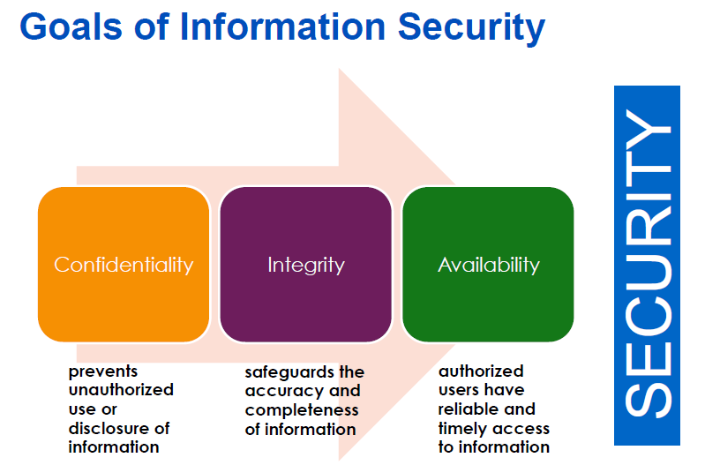

Slide 4
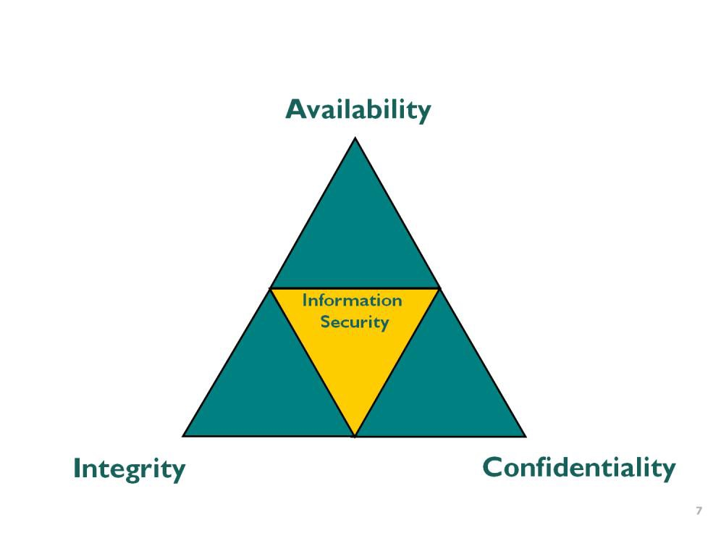
AIC Traid
Confidentiality - Is the concept of protecting the secrecy and privacy of information
Integrity - Is the concept of protecting the “accuracy” of information processing and data from improper modification.
Availability - Is the concept of ensuring that the systems and data can be accessed when required.

Slide 5



Security Needs for Communications
Confidentiality
Authentication
Availability
Interception
Forgery
Denial of Service
Is Private?
Who am I dealing with?
Wish to access!!
Integrity
Non-Repudiation
Access Control
Not
SENT !
Modification
Claim
Unauthorized access
Has been altered?
Who sent/received it?
Have you privilege?

Slide 6
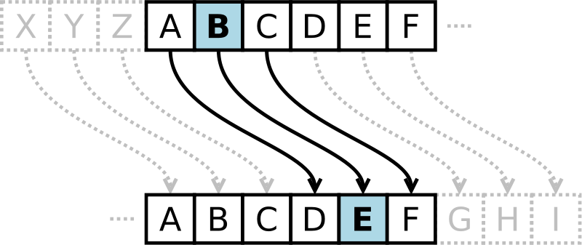
What Is Cryptography
Cryptography is the science of hiding information in plain sight, in order to conceal it from unauthorized parties.
Substitution cipher first used by Caesar for battlefield communications

Slide 7
What is Cryptography?
Cryptography derived its name from a Greek word called “Kryptos” which means “Hidden Secrets”.
Cryptography is the practice and study of hiding information.
It is the Art or Science of converting a plain intelligible data into an unintelligible data and again retransforming that message into its original form.
It provides Confidentiality, Integrity, Accuracy.

Slide 8
Encryption Terms and Operations
Plaintext – an original message
Ciphertext – an encrypted message
Encryption – the process of transforming plaintext into ciphertext (also encipher)
Decryption – the process of transforming ciphertext into plaintext (also decipher)
Encryption key – the text value required to encrypt and decrypt data

Slide 9
Secure Communications
Encryption Key
Decryption Key
Alice
plaintext
Encrypt
ciphertext
Decrypt
Bob
Mallory/ Oscar
Eve
Enemy or Adversary
Fig. Basic Communication Scenario

Slide 10
What is Encryption / Decryption
Encryption –
The process of converting plain text into an unintelligible format (cipher text) is called Encryption.
Decryption –
The process of converting cipher text into a plain text is called Decryption.

Slide 11
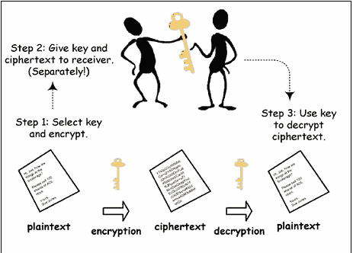
What are the Types of Cryptography
Symmetric Key Cryptography (Secret Key Cryptography)
Same Key is used by both parties
Advantages
Simpler and Faster
Disadvantages
Less Secured
Image taken from :-
www.google.com

Slide 12
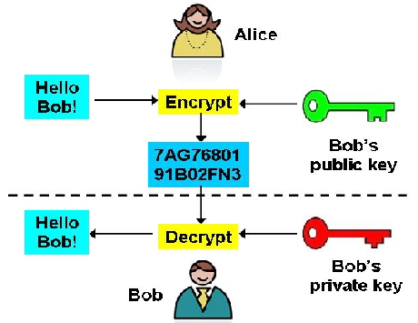
Asymmetric Key Cryptography (Public Key Cryptography)
2 different keys are used
Users get the Key from an Certificate Authority
Advantages
More Secured
Authentication
Disadvantages
Relatively Complex
Image taken from :-
www.google.com

Slide 13
What is a Key?
In cryptography, a key is a variable value that is applied using an algorithm to a string or block of unencrypted text to produce encrypted text, or to decrypt encrypted text.
The length of the key is a factor in considering how difficult it will be to decrypt the text in a given message.

Slide 14
Encryption Methodologies

Slide 15
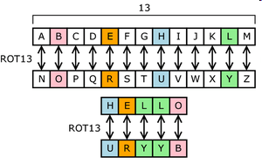
Substitution Cipher
Plaintext characters are substituted to form ciphertext
“A” becomes “R”, “B” becomes “G”, etc.
Character rotation
Caesar rotated three to the right (A > D, B > E, C > F, etc.)
A table or formula is used
ROT13 is a Caesar cipher
Subject to frequency analysis attack

Slide 16
Transposition Cipher
Plaintext messages are transposed into ciphertext
Plaintext: ATTACK AT ONCE VIA NORTH BRIDGE
Write into columns going down
Read from columns to the right
Ciphertext:
AKCNBTAEORTTVRIAOITDCNAHG
Subject to frequency analysis attack
A | K | C | N | B
T | A | E | O | R
T | T | V | R | I
A | O | I | T | D
C | N | A | H | G

Slide 17
Mono-alphabetic Cipher
One alphabetic character is substituted or another
Caesar right-three shift:
Or a more random scheme:
Subject to frequency analysis attack
A | B | C | D | E | F | G | H | I | J | … | Z
D | E | F | G | H | I | J | K | L | M | … | C
A | B | C | D | E | F | G | H | I | J | … | Z
W | E | R | T | B | N | P | Q | C | U | … | X

Slide 18
Running-key Cipher
Plaintext letters converted to numeric (A=0, B=1, etc.)
Plaintext values “added” to key values giving ciphertext
Modulo arithmetic is used to keep results in range 0-26
Add 26 if results < 0; subtract 26 if results > 26
Plaintext | A | T | T | A | C | K | A | T | O | N | C | E | V | I | A | N
Key | S | E | C | R | E | T | S | E | C | R | E | T | S | E | C | R
Plaintext | 0 | 19 | 19 | 0 | 2 | 10 | 0 | 19 | 14 | 13 | 2 | 4 | 21 | 8 | 0 | 13
Key | 18 | 4 | 2 | 17 | 4 | 19 | 18 | 4 | 2 | 17 | 4 | 19 | 18 | 4 | 2 | 17
Sum | 18 | 23 | 21 | 17 | 6 | 3 | 18 | 23 | 16 | 4 | 7 | 23 | 11 | 12 | 2 | 4
Ciphertext | S | X | V | R | G | D | S | X | Q | E | H | X | L | M | C | E

Slide 19
Types of Encryption
Block cipher
Encrypts blocks of data, often 128 bits
Stream cipher
Operates on a continuous stream of data

Slide 20
Block Ciphers
Encrypt and decrypt a block of data at a time
Typically 128 bits
Typical uses for block ciphers
Files, e-mail messages, text communications, web
Well known encryption algorithms
DES, 3DES, AES, CAST, Twofish, Blowfish, Serpent

Slide 21
Stream Ciphers
Used to encrypt a continuous stream of data, such as an audio or video transmission
A stream cipher is a substitution cipher that typically uses an exclusive-or (XOR) operation that can be performed very quickly by a computer.
Plaintext | 1 | 1 | 0 | 1 | 0 | 0 | 1 | 1 | 0 | 1 | 0 | 0 | 1 | 1 | 0 | 0
Key | 0 | 1 | 1 | 0 | 1 | 0 | 0 | 1 | 0 | 1 | 1 | 0 | 1 | 0 | 1 | 0
Ciphertext | 1 | 0 | 1 | 1 | 1 | 0 | 1 | 0 | 0 | 0 | 1 | 0 | 0 | 1 | 1 | 0
Encryption: simple XOR with key
Ciphertext | 1 | 0 | 1 | 1 | 1 | 0 | 1 | 0 | 0 | 0 | 1 | 0 | 0 | 1 | 1 | 0
Key | 0 | 1 | 1 | 0 | 1 | 0 | 0 | 1 | 0 | 1 | 1 | 0 | 1 | 0 | 1 | 0
Plaintext | 1 | 1 | 0 | 1 | 0 | 0 | 1 | 1 | 0 | 1 | 0 | 0 | 1 | 1 | 0 | 0
Decryption: simple XOR with the same key

Slide 22
Stream Ciphers (cont.)
Encryption: simple XOR with key:
Decryption: simple XOR with the same key:
Plaintext | 1 | 1 | 0 | 1 | 0 | 0 | 1 | 1 | 0 | 1 | 0 | 0 | 1 | 1 | 0 | 0
Key | 0 | 1 | 1 | 0 | 1 | 0 | 0 | 1 | 0 | 1 | 1 | 0 | 1 | 0 | 1 | 0
Ciphertext | 1 | 0 | 1 | 1 | 1 | 0 | 1 | 0 | 0 | 0 | 1 | 0 | 0 | 1 | 1 | 0
Ciphertext | 1 | 0 | 1 | 1 | 1 | 0 | 1 | 0 | 0 | 0 | 1 | 0 | 0 | 1 | 1 | 0
Key | 0 | 1 | 1 | 0 | 1 | 0 | 0 | 1 | 0 | 1 | 1 | 0 | 1 | 0 | 1 | 0
Plaintext | 1 | 1 | 0 | 1 | 0 | 0 | 1 | 1 | 0 | 1 | 0 | 0 | 1 | 1 | 0 | 0

Slide 23
Symmetric key
A common secret that all parties must know
Difficult to distribute key securely
Used by DES, 3DES, AES, Twofish, Blowfish, IDEA, RC5
Fig. Symmetric cryptography

Slide 24
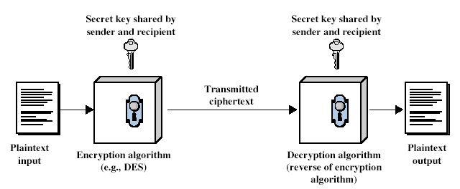
Symmetric Cipher Model
24
Notes:
Detail the five ingredients of the symmetric cipher model, shown in Stallings Figure 2.1:
plaintext - original message
encryption algorithm – performs substitutions/transformations on plaintext
secret key – control exact substitutions/transformations used in encryption algorithm
ciphertext - scrambled message
decryption algorithm – inverse of encryption algorithm

Slide 25
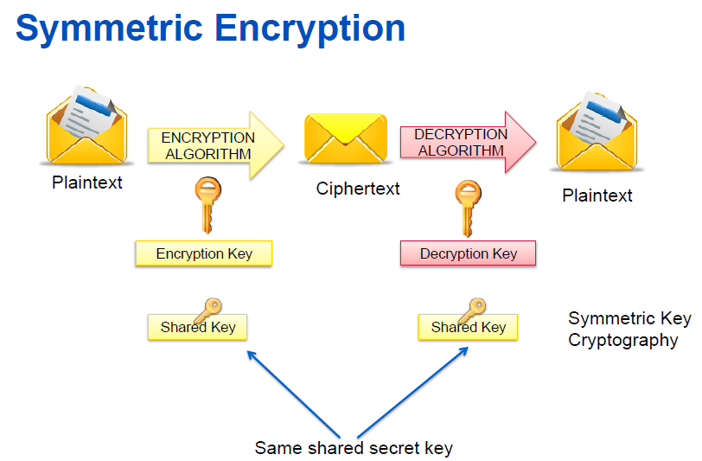

Slide 26
Asymmetric key
Public / private key
Keys mathematically tied together
Openly distribute public key to all parties
Keep private key secret
Anyone can use your public key to send you a message
Used by RSA. El Gamal, Elliptic Curve
Fig. Asymmetric cryptography

Slide 27
Public-Key Cryptography
public-key/two-key/asymmetric cryptography involves the use of two keys:
a public-key, which may be known by anybody, and can be used to encrypt messages, and verify signatures
a private-key, known only to the recipient, used to decrypt messages, and sign (create) signatures
is asymmetric because
those who encrypt messages or verify signatures cannot decrypt messages or create signatures

Slide 28
Asymmetric Encryption Uses
Encrypt message with recipient's public key
Only recipient can read it, using his or her private key
Provides confidentiality
Sign message
Hash message, encrypt hash with your private key
Anyone can verify the signature using your public key
Provides integrity and non-repudiation (sender cannot deny authorship)
Sign and encrypt
Both of the above

Slide 29
Symmetric Cryptography

Slide 30
Data Encryption Standard (DES)
The Data Encryption Standard (DES) is a symmetric-key block cipher published by the National Institute of Standards and Technology (NIST).
In 1973, NIST published a request for proposals for a national symmetric-key cryptosystem. A proposal from IBM, a modification of a project called Lucifer, was accepted as DES. DES was published in the Federal Register in March 1975 as a draft of the Federal Information Processing Standard (FIPS).
There has been considerable controversy over the design, particularly in the choice of a 56-bit key.

Slide 31
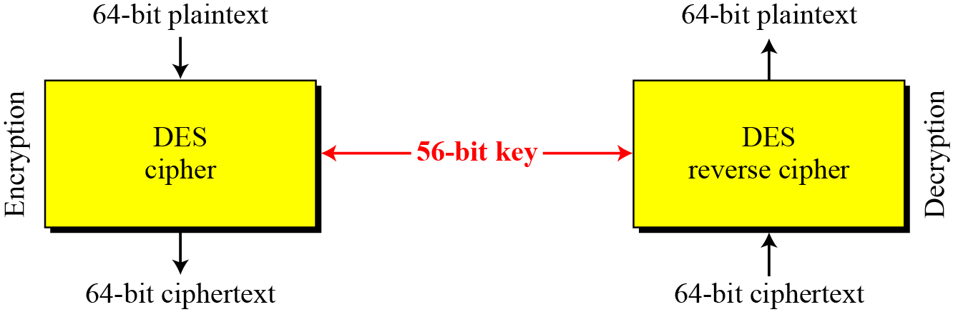
DES Overview
Figure Encryption and decryption with DES

Slide 32
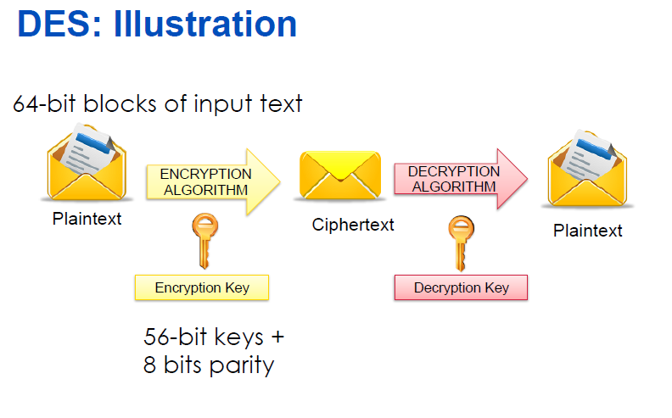

Slide 33
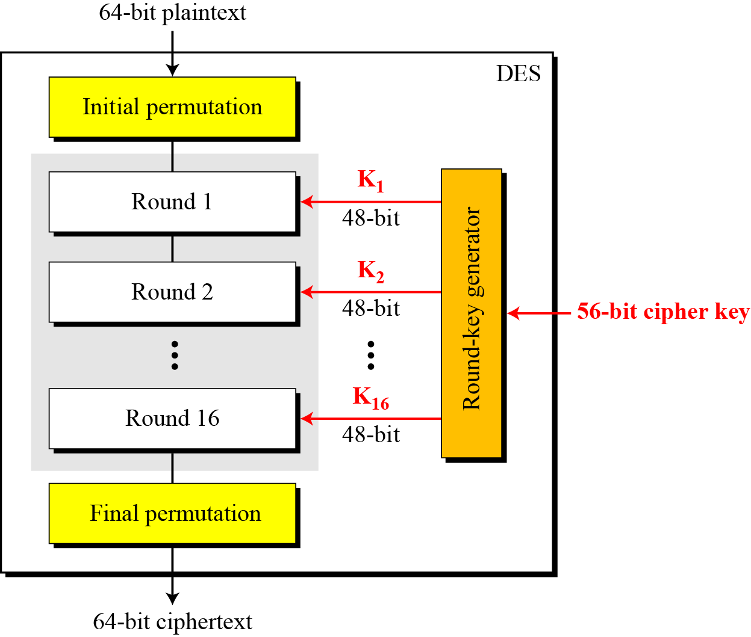
DES Structure
The encryption process is made of two permutations (P-boxes), which we call initial and final permutations, and sixteen rounds of complex key dependent calculation.

Slide 34
DES - Basics
Fundamentally DES performs only two operations on its input, bit shifting (permutation), and bit substitution.
The key controls exactly how this process works.
By doing these operations repeatedly and in a non-linear manner you end up with a result which can not be used to retrieve the original without the key.
By applying relatively simple operations repeatedly a system can achieve a state of near total randomness.

Slide 35
Each Iteration Use of a Different Sub-key
DES works on 64 bits of data at a time. Each 64 bits of data is iterated on from 1 to 16 times (16 is the DES standard).
For each iteration a 48 bit subset of the 56 bit key is fed into the encryption block
Decryption is the inverse of the encryption process.

Slide 36
DES Key Processing
The key is usually stored as a 64-bit number, where every eighth bit is a parity bit.
The parity bits are pitched during the algorithm, and the 56-bit key is used to create 16 different 48-bit subkeys - one for each round.
Subkeys Generation
First, the key is loaded according to the PC-1 and then halved.
Then each half is rotated by 2 bits in every round except the first, second, 9th and last rounds.
The reason for this is that it makes it secure against related-key cryptanalysis.
Then 48 of the 56 bits are chosen according to a compression permutation.

Slide 37
The Key Schedule
The subkeys used by the 16 rounds are formed by the key schedule which consists of:
An initial permutation of the key (PC1) which selects 56-bits in two 28-bit halves
16 stages consisting of
selecting 24-bits from each half and permuting them by PC2 for use in function f,
rotating each half either 1 or 2 places depending on the key rotation schedule KS

Slide 38
3DES or Triple-DES
Triple-DES is a block cipher, which applies the Data Encryption Standard (DES) cipher algorithm three times to each data block.
DES used a single 56-bit key.
3DES uses three 56-bit keys (often just referred to as a 3DES key), and performs three rounds of DES operations on the data.
The result is that DES technology could be used until long term solution (the Advanced Encryption Standard) is found.

Slide 39
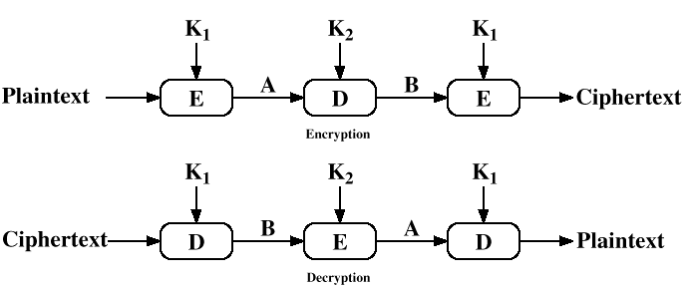
Triple DES - More Secure

Slide 40
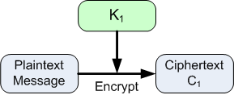
3DES
A typical application of 3DES is known as EDE (Encrypt-Decrypt-Encrypt).
In this case, the first and third keys are equal, so the effective key length is 112-bits.
In the first operation, the plaintext is encrypted with the first DES key, K₁.

Slide 41
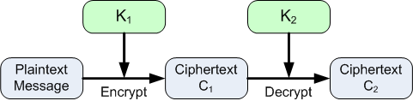
3DES
In the second step, the results of the first step, C₁, is decrypted using the second key, K₂
Since K₂ ≠ K₁, this does not result in the original plaintext message.

Slide 42
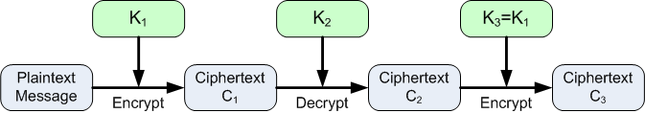
3DES
In the final step, the results of the second step, C₂, is encrypted using the third key, K₃
The output ciphertext C₃ is the final encrypted message.
Recall that K₃ = K₁ in this case, so even though there are three 56-bit keys, the effective key length is only 112-bits.

Slide 43
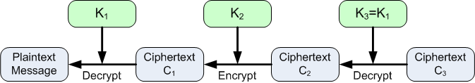
3DES or Triple-DES
Decryption in this case follows the reverse of the encryption process, as shown below.

Slide 44
3DES or Triple-DES
Although the length of the key has doubled, there are 2⁵⁶ (= 72,057,594,037,927,936) times as many keys.
Therefore a brute force search for a 3DES-EDE key would take 2⁵⁶ times longer on the same hardware than a brute force search for a DES key.
There are some approaches that can recover 3DES keys more quickly than brute force searches, but for many kinds of data 3DES is still an acceptable encryption method.

Slide 45
What is AES?
The Advanced Encryption Standard (AES) is a specification for the Encryption of electronic data.
The algorithm described by AES is a Symmetric-Key Algorithm, meaning the same key is used for encrypting and decrypting the data. AES standard is a variant of Rijndael where the block size is restricted to 128bits and the key size of 128, 192, 256 bits can be used.
AES is based on a design principle known as a substitution-permutation network, and is fast in both software and hardware.

Slide 46
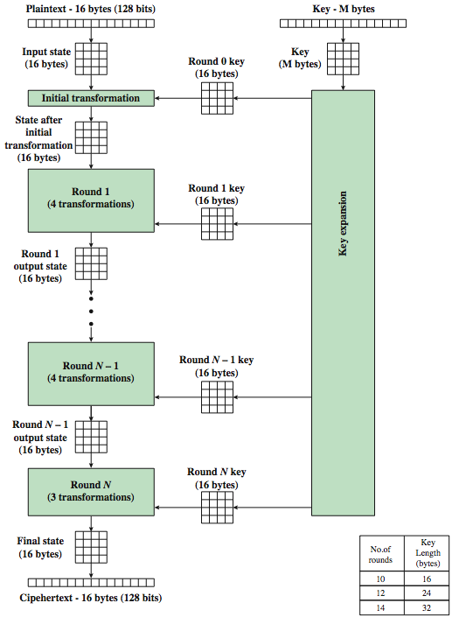
AES Encryption Process
Notes:
46
Stallings Figure 5.1 shows the overall encryption process in AES.

Slide 47
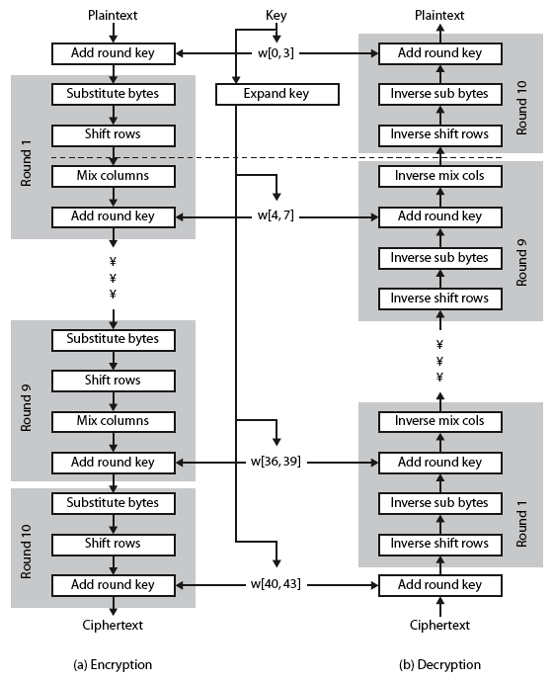
AES Structure
Notes:
47
Stallings Figure 5.3 shows the structure of AES in more detail. The cipher consists of N rounds, where the number of rounds depends on the key length: 10 rounds for a 16-byte key; 12 rounds for a 24-byte key; and 14 rounds for a 32-byte key. The first N – 1 rounds consist of four distinct transformation functions: SubBytes, ShiftRows, MixColumns, and AddRoundKey, which are described subsequently. The final round contains only 3 transformation, and there is a initial single transformation (AddRoundKey) before the first round, which can be considered Round 0. Each transformation takes one or more 4 x 4 matrices as input and produces a 4 x 4 matrix as output. Figure 5.1 shows that the output of each round is a 4 x 4 matrix, with the output of the final round being the ciphertext. Also, the key expansion function generates N + 1 round keys, each of which is a distinct 4 x 4 matrix. Each round key serve as one of the inputs to the AddRoundKey transformation in each round.

Slide 48
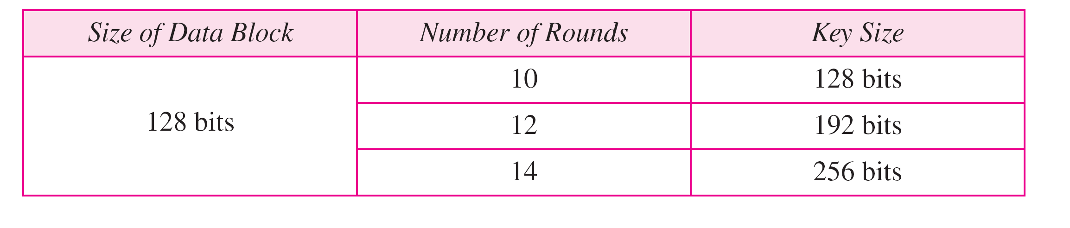
Table: AES configuration

Slide 49
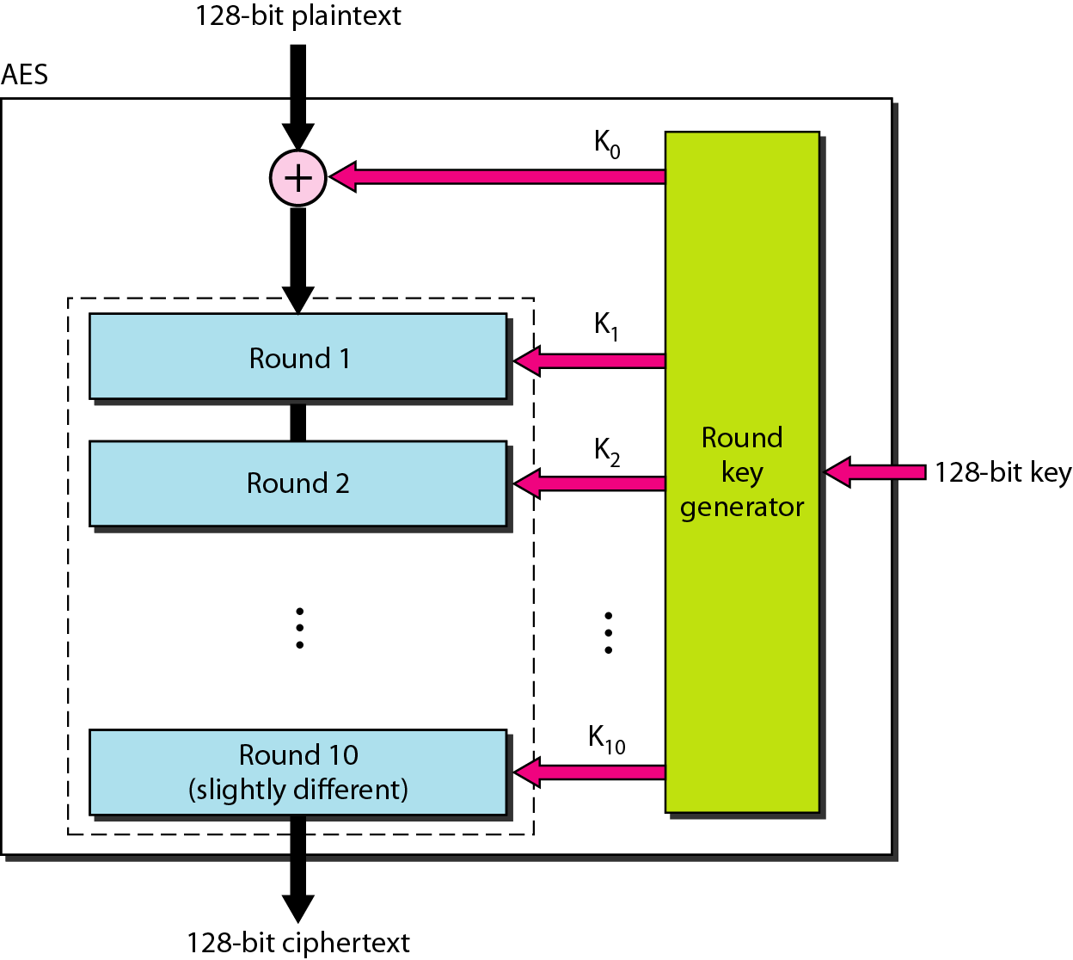
Figure : Advance Encryption Standard

Slide 50
AES
10-round, 128-bit key configuration. The structure and operation of the other configurations are similar.
The difference lies in the key generation.
The general structure is shown in Figure .
There is an initial XOR operation followed by 10 round ciphers. The last round is slightly different from the preceding rounds; it is missing one operation.
Although the 10 iteration blocks are almost identical, each uses a different key derived from the original key.

Slide 51
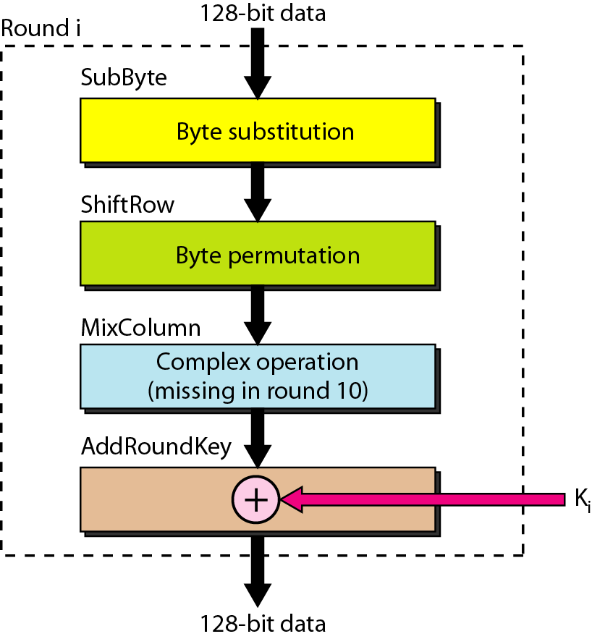
Figure : Structure of each round

Slide 52
Structure of Each Round
Each round of AES, except for the last, is a cipher with four operations that are invertible.
The last round has only three operations. Figure is a flowchart that shows the operations in each round.
Each of the four operations used in each round uses a complex cipher

Slide 53
DES Encryption | AES Encryption
DES uses only 56 bits key which provides a combination of 2^56 = 256 combinations for encryption. | AES can use 128, 192, 256 bits keys which provides 2^128, 2^192, 2^256 combinations for encryption.
DES is restricted to use a Block Size of only 64 bits | AES is restricted to use a Block Size of 128 bits (double of what is used in DES)
With 64 bits block size, the amount of data that can be transferred with a single encryption key is just 32GB. | With AES, it is possible to transfer around 256 billion GB of data. It is probably safe to say that you can use a single AES encryption key for any application.
DES uses a Feistel network, which divides the block into 2 halves before going through the Encryption steps. | AES uses Permutation-Substitution method, which involves a series of substitution and permutation steps to create the encrypted block.
DES encryption is breakable through Brute Force attack. | AES encryption on the other hand is still not breakable, though there are some theoretical discussions about breaking the AES.
DES is an old technique used for encryption/decryption | AES is relatively new.

Slide 54
Symmetric Key Encryption- Strength
The strengths of modern symmetric key encryption algorithms include:
Fairly fast encryption/decryption process (in comparison to public key techniques, for example)
Several well known, well tested algorithms are available, including 3DES and AES.
Library implementations of symmetric key algorithms are commonly available for many programming languages.

Slide 55
Rivest, Shamir, Adelman algorithm (RSA)
Rivest, Shamir, Adelman algorithm (RSA)
One of the most well-known public key cryptosystems
Developed in the late 1970’s
Relies on the fact that it is extremely difficult to factor large prime numbers

Slide 56
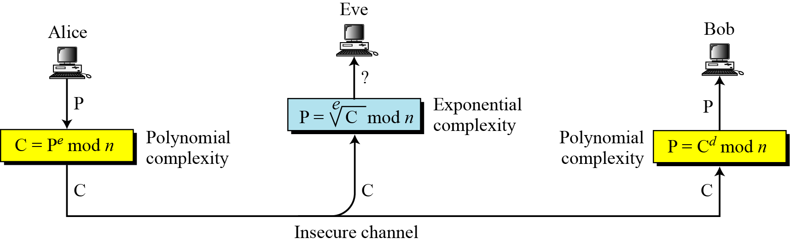
RSA Cryptosystem
The most common public-key algorithm is the RSA cryptosystem, named for its inventors (Rivest, Shamir, and Adleman).

Slide 57
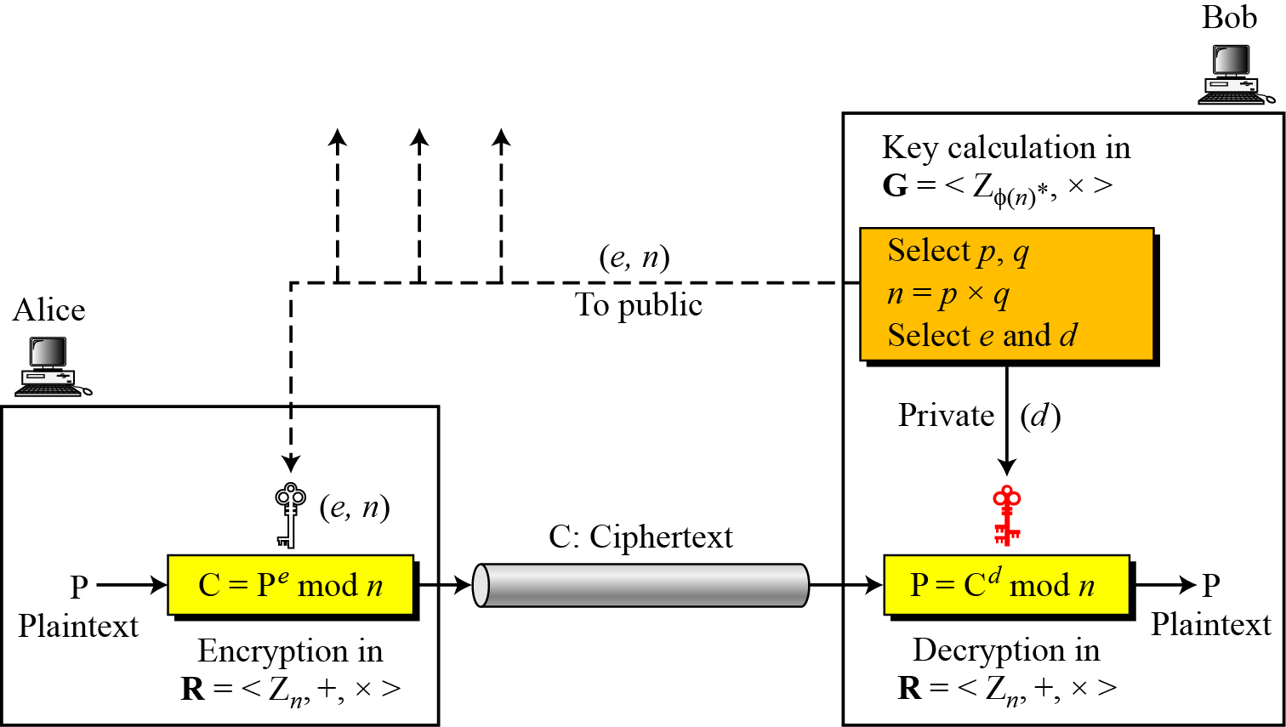
Encryption, decryption, and key generation in RSA

Slide 58
Selecting Keys
The two keys, e and d, have a special relationship to each other,
Selecting Keys
Bob use the following steps to select the private and public keys:
1. Bob chooses two very large prime numbers p and q. Remember that a prime number is one that can be divided evenly only by 1 and itself.
2. Bob multiplies the above two primes to find n, the modulus for encryption and decryption. In other words, n = p X q.
3. Bob calculates another number ø = (p -1) X (q - 1).
4. Bob chooses a random integer e. He then calculates d so that d x e= 1 mod ø
5. Bob announces e and n to the public; he keeps ø and d secret.

Slide 59
Encryption
Anyone who needs to send a message to Bob can use n and e. For example, if Alice needs to send a message to Bob, she can change the message, usually a short one, to an integer.
This is the plaintext. She then calculates the ciphertext, using e and n.
C=P^e(mod n)
Alice sends C, the ciphertext, to Bob.

Slide 60
Decryption
Bob keeps ø and d private.
When he receives the ciphertext, he uses his private key d to decrypt the message:
P= C^d(mod n)

Slide 61
Restriction
For RSA to work, the value of P must be less than the value of n.
If P is a large number, the plaintext needs to be divided into blocks to make P less than n.

Slide 63
Encryption

Slide 64
Decryption

Slide 65
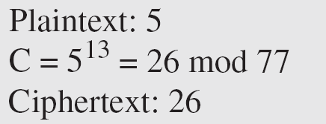
Example
Bob chooses 7 and 11 as p and q and calculates n = 7 · 11 = 77. The value of F = (7 − 1) (11 − 1) or 60. Now he chooses two keys, e and d. If he chooses e to be 13, then d is 37. Now imagine Alice sends the plaintext 5 to Bob. She uses the public key 13 to encrypt 5.

Slide 66
Example (continued)
Bob receives the ciphertext 26 and uses the private key 37 to decipher the ciphertext:
The plaintext 5 sent by Alice is received as plaintext 5 by Bob.

Slide 67
Digital Signature: Outline
What is a Digital Signature
Digital Signature Features
Digital Signature Concepts
How Digital Signature Works

Slide 68
Digital Signature
Digital signature means a type of electronic signature that transforms a message using an asymmetric cryptosystem ( public and private key capability )
A person having the initial message and the signer’s public key can accurately determine
Whether the transformation was created using the private key that corresponds to the signer’s public key
Whether the initial message has been altered since the transformation was made

Slide 69
A Digital Signature is:
Intended by the party using it to have the same force and effect as the use of a manual signature
Unique to the party using it
Capable of verification
Under the sole control of the party using it
Linked to data in such a manner that it is invalidated if the data is changed
In conformity with rules adopted by Office of Controller of Certification (a Certificate Authority) pursuant to this act

Slide 70
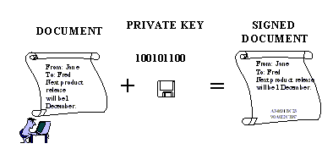
Digital Signature

Slide 71
Digital Signature Features
Signer authentication
Message authentication
Non-repudiation
Integrity

Slide 72
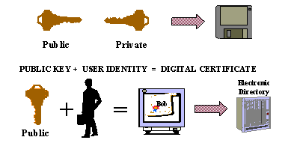
Digital Signature Concepts
The first is that each user has a pair of matching virtual keys ( the private key and public key ), which have a unique mathematical relationship
The second concept is that of a digital certificate

Slide 73
Public-key Cryptography
Each person’s public key is published while the private key is kept secret
Communications involve only the public keys, and no private key is ever transmitted or shared.
The public keys are associated with their users in a trusted manner

Slide 74
Public-key Cryptography
Anyone can send a confidential message by just using public information, but the message can only be decrypted with a private key
Public-key cryptography can be used not only for privacy (encryption), but also for authentication (digital signatures)

Slide 75
Certificate Authority
The Certificate Authority is an individual organization that acts as a notary to authenticate the identity of users of a public-key encryption
A Certificate Authority is used to: 1) Associate a pair of keys with a person 2) Publishing the public keys in a directory 3) Maintain functions associated with the keys

Slide 76
Digital Certificate
The digital certificate acts like an electronic envelope in which the public key travels
This electronic ID file verifies the connection between the public key and the owner
The digital certificate is issued by a Certificate Authority and signed with that Certificate Authority’s private key, authenticating the public key

Slide 77
Digital Certificate
Typically includes:
Public key and owner’s name
Certificate Authority issuing the key
Serial number
Digital signature of Certificate Authority, signed using the Certificate Authority’s private key
Other optional identifying information

Slide 78
Digital Signature Creation
Message
Message
Hash
Function
Message
Digest
Signature
Function
Digital
Signature
Signature Private Key

Slide 79
Digital Signature Creation
Sign
A process known as hash function must occur 1) A hash function is a mathematical algorithm which creates a digital representation or fingerprint in the form of a hash result or message digest
2) The hash function generally consists of a standard length that is usually much smaller than the message but nevertheless substantially unique to it

Slide 80
Digital Signature Creation
Sign
The sender’s digital signature software transforms the hash result into a digital signature using the sender’s private key
Seal
The message is encrypted with a fast symmetric key
Then the symmetric key is encrypted with the receiver’s public key

Slide 81
Digital Signature Verification
If the message
digest are identical,
the signature is valid.
If they are different,
the signature is not
valid.
Message
Hash Function
Message
Digest
Digest
Signature
Signature
Function
Message
Digest
Signer’s Public Key

Slide 82
Digital Signature Verification
Accept
Open
The receiver decrypts the symmetric key by using the receiver’s private key
The message is decrypted using the symmetric key
Verify
Accomplished by computing a new hash result of the original message

Slide 83
Digital Signature Verification
Verify
Then, using the sender’s public key and the new hash result, the verifier checks whether:
1) the digital signature was created using the corresponding private key
2) the newly computed hash result matches the original hash result
The software will confirm the digital signature as:
1)verified
2) failed

Slide 84
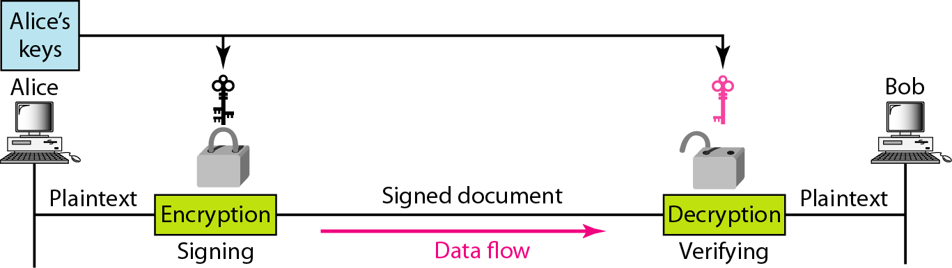
Figure : Signing the message itself in digital signature

Slide 85
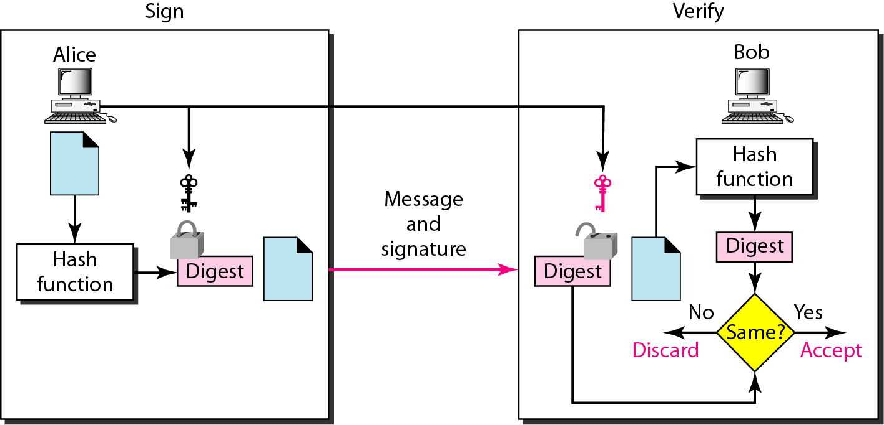
Figure : Signing the digest in a digital signature

Slide 86
Summary
Digital signature is based on asymmetric cryptography
Every user has a unique pair of private and public key certified by a trusted Certification Authority
When the sender signs a transaction, a unique mathematical code is created with their private key and the actual content of the transaction
Digital signature can identify the signer’s identity by its relationship to the digital certificate
Digital signature provides more value than any other electronic signature method

Slide 87
Summary
Digital signatures are used to add integrity and non-repudiation functionality to cryptosystems
Digital signatures are created using hash functions applied to the message to create a message digest that is then encrypted
Digital certificates allow a third party Certificate Authority to verify the identity of a sender who may not be well known to the recipient
A digital certificate is a copy of a user’s public key that has been digitally signed by a Certificate Authority.

Slide 88
Typical Network Architecture
e-mail,
DNS
www
Firewall
Internal
Network
Router
Internet
Internet

Slide 89
FIREWALLS
A firewall is a device installed between the internal network of an organization and the rest of the Internet.
It is designed to forward some packets and filter (not forward) others.
Firewall can be used to deny access to specific host or specific service in the organization.
A firewall is usually classified as packet filter or proxy based .
A firewall is a network security system that monitors and controls over all your incoming and outgoing network traffic based on advanced and a defined set of security rules.

Slide 90
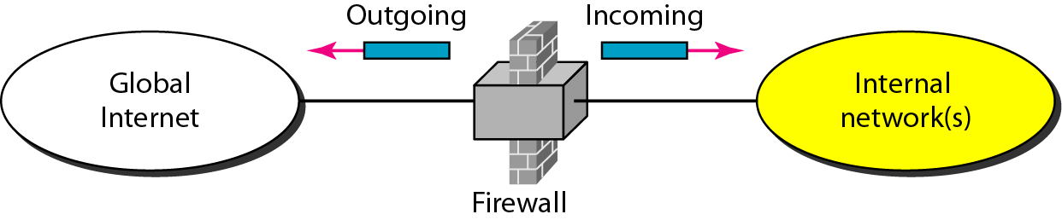
Figure . Firewall

Slide 91
Packet-filter firewall
It can forward or block packets based on the information in the network and transport layer headers: source and destination IP addresses, source and destination port addresses, any type of protocol (TCP or UDP)
Is a router that uses a filtering table to decide which packets must be discarded.

Slide 92
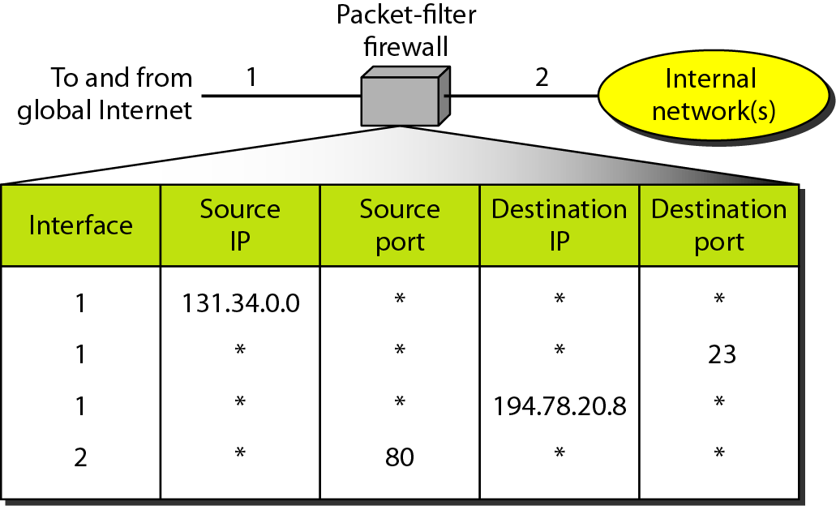
Figure : Packet-filter firewall

Slide 93
A packet-filter firewall filters at the network or transport layer.

Slide 94
Proxy Firewall
Sometimes we need to filter a message based on the information available in the message itself.
In this case packet filter is not feasible because it cannot distinguish between different packets arriving at TCP port (HTTP).Testing must be done at the application level( Using URLs)
One solution is to install a proxy computer, which stands between the customer and the corporation computer.

Slide 95
Proxy Firewall
When the user client process sends a message, the proxy firewall runs a server process to receive the request.
The server opens the packet at the application level and finds out if the request is legitimate.
If it is , the server acts as a client process and sends the message to the real server in the cooperation .
If it is not , the message is dropped and an error message is sent to external user. In this way , the requests of the external users are filtered based on the contents at the application layer.

Slide 96
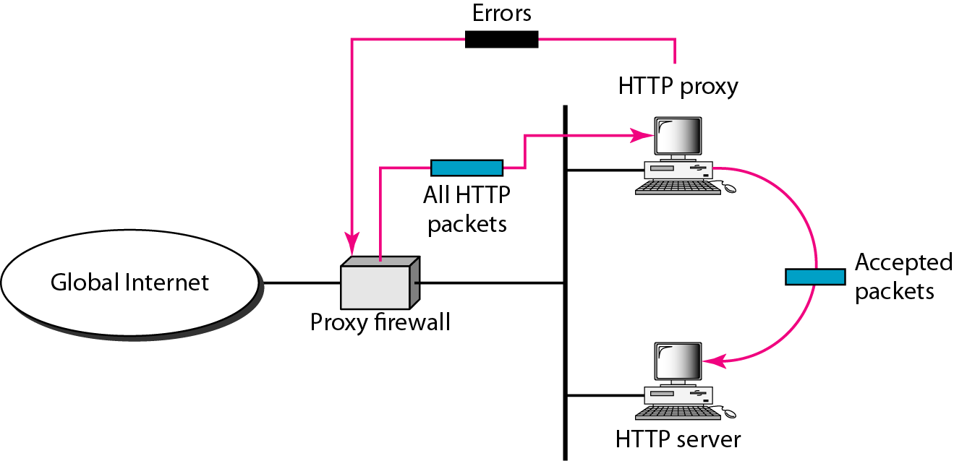
Figure : Proxy firewall

Slide 97
A proxy firewall filters at the application layer.

